Slide 1

Design & Analysis of Majority Logic based Approximate Adders & Multipliers
IIIT Bangalore
Group 13
April 11, 2023

Slide 2
Agenda
01. Introduction
02. Synopsis
03. Implementation
04. Epilogue
05. References

Slide 3

INTRODUCTION

Slide 4
Approximate Computing
Approximate computing is a computing paradigm that aims to provide efficient and low-power solutions to computational problems by relaxing the requirement for exact computation and allowing for some degree of error or imprecision in the results. The basic idea behind approximate computing is to trade-off accuracy for efficiency, by accepting some level of error or inexactness in exchange for gains in speed, power consumption, or other performance metrics.
Why approximation?
Approximation becomes necessary when exact computation is too expensive, time-consuming, or impossible to achieve.
In many real-world applications, exact computation may require too many resources or be impractical due to limitations in the available technology, the amount of data to be processed, or the complexity of the problem being solved.
Approximate methods offer a flexible and efficient approach to addressing such challenges, by providing a range of trade-offs between accuracy and performance, depending on the specific requirements of the problem being solved.
Approximate computing has been used in a variety of domains where the applications are error-tolerant, such as multimedia processing, machine learning, signal processing, scientific computing. Therefore, approximate computing is mostly driven by applications that are related to human perception/cognition and have inherent error resilience.
How to accomplish?
Hardware: Approximate circuits, Voltage scaling, Storages and Systems
Software: Reduced-precision arithmetic, Approximate algorithm, Code optimization

Slide 5
Aim
The paper proposes the following designs:
A new 2-bit MLAFA (Majority Logic Approximate Full Adder) is proposed based on truth table reduction; it can be used for multi-bit approximate adder design;
A 2 x 2 MLAM (Majority Logic Approximate Multiplier) is proposed and complement bits are introduced;
A novel analysis for selecting complement bits is presented;
MLACs (Majority Logic Approximate Compressors) based on K-Map simplification and 1-bit MLAFAs are proposed;
Exact as well as approximate pipelined reduction circuits for 4 x 4 and 8 x 8 MLAMs are proposed.

Slide 6

SYNOPSIS

Slide 7
Majority Logic
A | B | C | F
0 | 0 | 0 | 0
0 | 0 | 1 | 0
0 | 1 | 0 | 0
0 | 1 | 1 | 1
1 | 0 | 0 | 0
1 | 0 | 1 | 1
1 | 1 | 0 | 1
1 | 1 | 1 | 1
Majority logic is a type of digital logic that operates on a set of input signals and produces an output signal based on the majority of the input signals.
In majority logic, the output signal is determined by counting the number of input signals that are asserted (i.e., have a logic level of 1) and comparing it to a threshold value.
If the number of asserted signals is greater than or equal to the threshold value, the output signal is asserted; otherwise, the output signal is negated (i.e., has a logic level of 0).
A majority gate is a logical gate used in circuit complexity and other applications of Boolean circuits. A majority gate returns true if and only if more than 50% of its inputs are true.
From Table 1, we can write:
F = M(A, B, C) = AB + BC + AC
Table 1 : Truth table of Majority gate

Slide 8
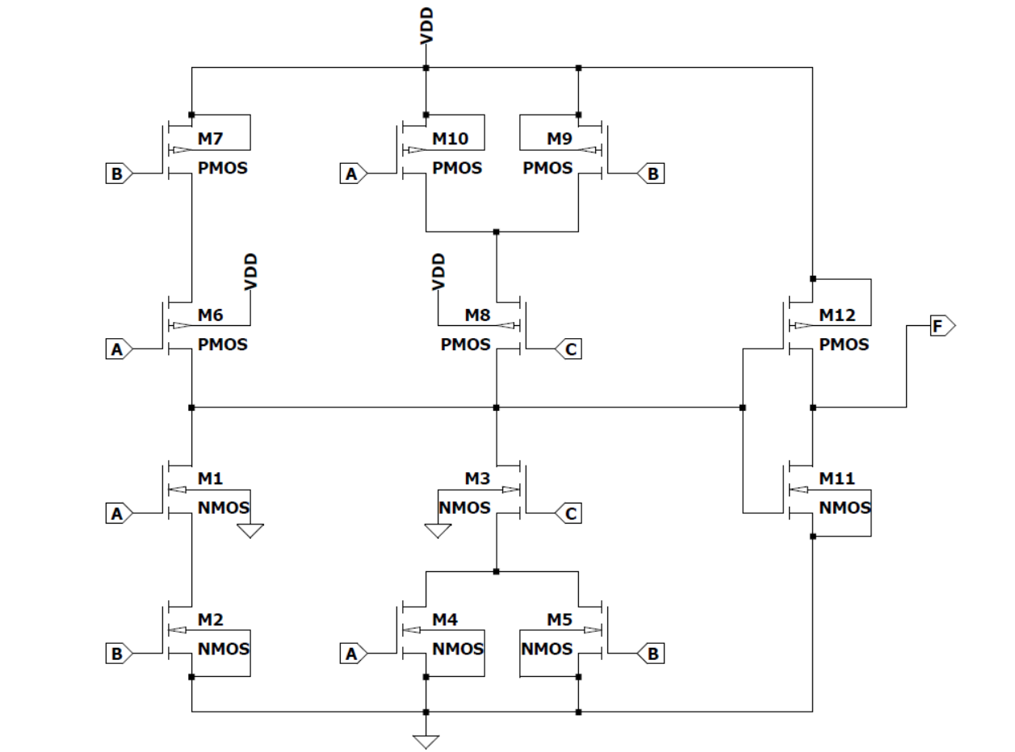
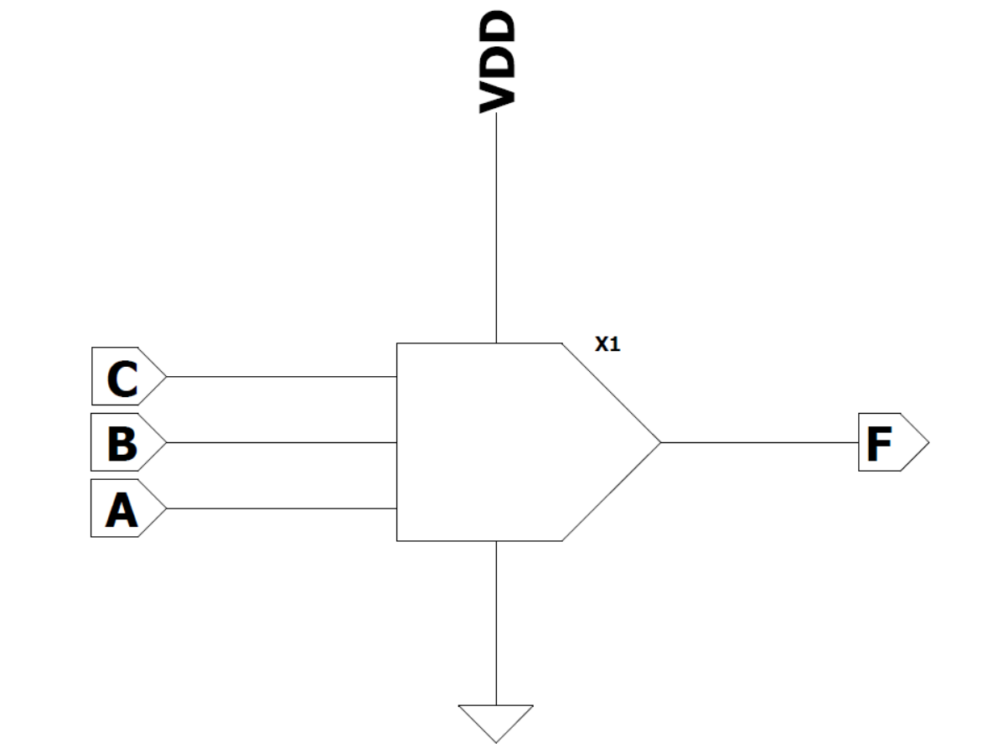
Why majority logic ?
As CMOS is approaching its technology limitations, emerging nanotechnologies have been proposed at the end of the Moore’s Law, such as Quantum-dot Cellular Automata (QCA), nanomagnetic logic (NML), and spin-wave devices (SWD). All of these technologies rely on majority logic (ML) as digital design framework; this is different from conventional Boolean logic.
Figure 1 : Majority gate schematic
Figure 2 : Majority gate cell view

Slide 9
Error Metrics
As approximate computing introduces errors, metrics are required to evaluate the accuracy of approximate circuits. This paper evaluate approximate designs by the Normalized Mean Error Distance (NMED), and the Maximum Absolute Error (MAE).
The NMED is the normalizing Mean Error Distance. The Mean Error Distance is defined as the average of the Error Distance (ED) which is the absolute difference between the approximate and the accurate results across all possible inputs. MAE is defined as the maximum absolute error.
The definitions of ED, MED, NMED, and MAE are as follows:
ED = |(ExR – ApR)|
MED = (∑ ED) / N
NMED = MED / MAX
MAE = max{ED},
where ExR, ApR, N and MAX denote the accurate result, the approximate result, the counts of all possible inputs and the maximum value of the result, respectively.

Slide 10
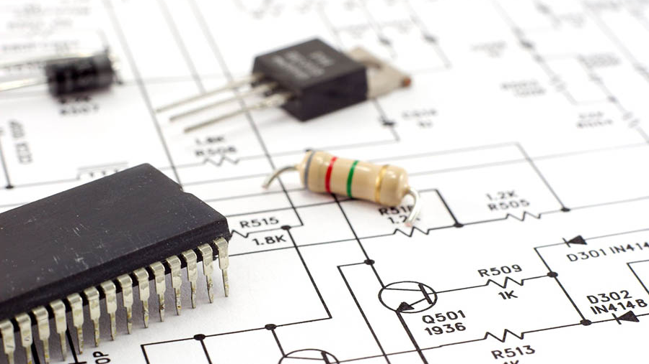
IMPLEMENTATION (I. Approximate Adder)

Slide 11
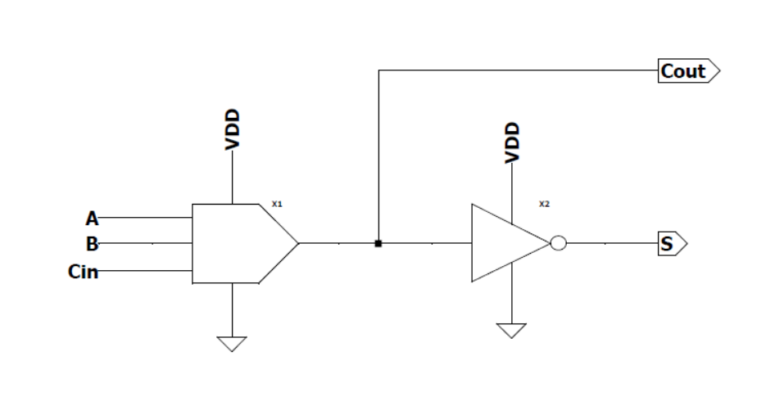
1 – Bit MLAFA
A | B | Cin | Cout | S
0 | 0 | 0 | 0 | 1
0 | 0 | 1 | 0 | 1
0 | 1 | 0 | 0 | 1
0 | 1 | 1 | 1 | 0
1 | 0 | 0 | 0 | 1
1 | 0 | 1 | 1 | 0
1 | 1 | 0 | 1 | 0
1 | 1 | 1 | 1 | 0
A 1 – bit MLAFA has been proposed in [1]. In the paper it is named as MLAFA1.
From Table 2, the equations for the carry out and the sum are as follows:
Cout = M(A, B, Cin)
S = ~Cout
Table 2 : MLAFA1 truth table
[1] C. Labrado, H. Thapliyal and F. Lombardi, "Design of majority logic based approximate arithmetic circuits," 2017 IEEE International Symposium on Circuits and Systems (ISCAS), Baltimore, MD, USA, 2017, pp. 1-4, doi: 10.1109/ISCAS.2017.8050819.
Figure 3 : MLAFA1 schematic diagram

Slide 12
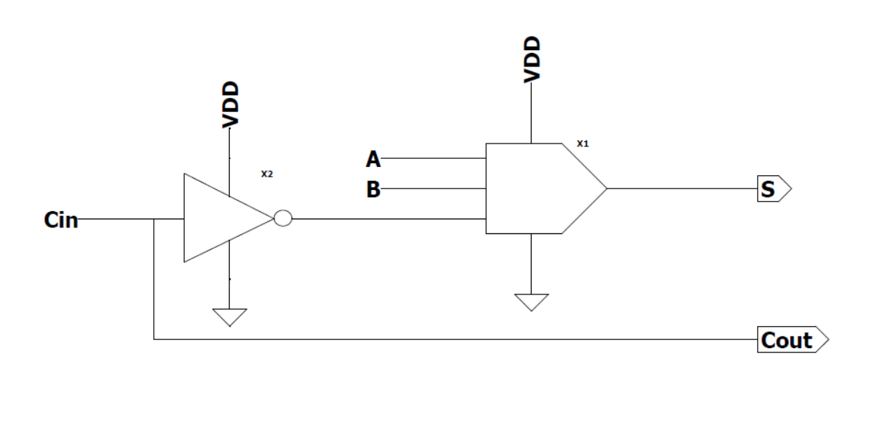
Proposed 1 – bit MLAFA
A new1 – bit MLAFA, namely MLAFA2 is proposed. The equations for the carry out and the sum are as follows:
Cout = Cin
S = M(~Cout, M(A, B, ~Cin), Cin) = M(A, B, ~Cin)
The MED and NMED of MLAFA2 are given by:
MED = (0+1+0+0+0+0+1+0) / 8 = 0.25
NMED = MED / 3 = 0.083
A | B | Cin | Cout | S
0 | 0 | 0 | 0 | 0
0 | 0 | 1 | 1 | 0
0 | 1 | 0 | 0 | 1
0 | 1 | 1 | 1 | 0
1 | 0 | 0 | 0 | 1
1 | 0 | 1 | 1 | 0
1 | 1 | 0 | 0 | 1
1 | 1 | 1 | 1 | 1
Table 3 : MLAFA1 truth table
Figure 4 : MLAFA2 schematic diagram

Slide 13
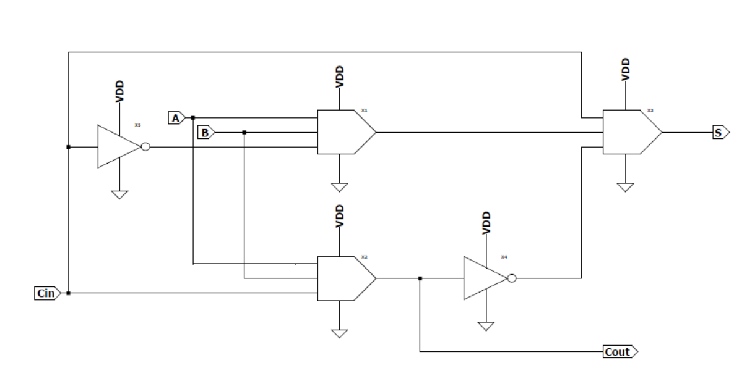
Figure 5 : EFA schematic diagram
Types | ML | INV | D_{sum} (in ps) | D_{cout} (in ps) | NMED | MAE
EFA | 3 | 2 | 180 | 95 | 0 | 0
MLAFA1 | 1 | 1 | 82 | 60 | 0.083 | 1
MLAFA2 | 1 | 1 | 78 | 0 | 0.083 | 1
Table 4 : Comparison of 1 – bit MLAFAs

Slide 14
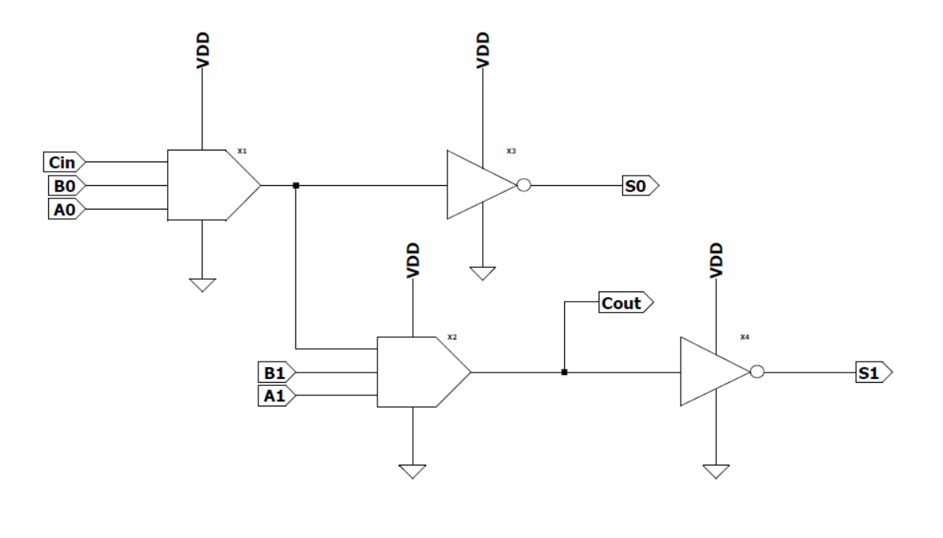
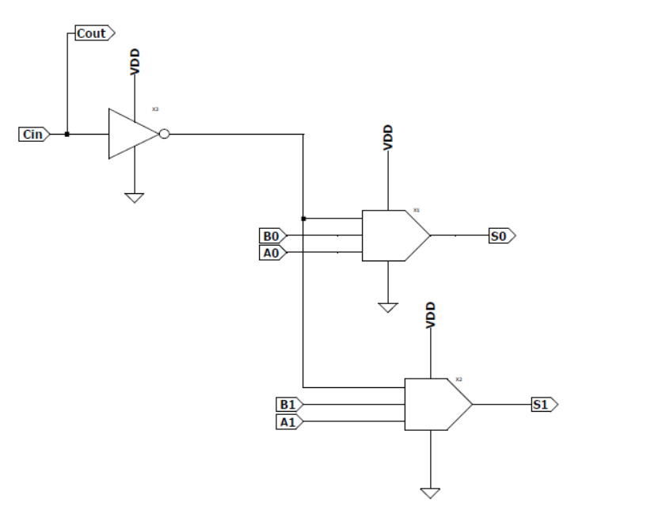
2 – Bit MLAFA
Figure 6.(a) : MLAFA11
Figure 6.(b) : MLAFA22

Slide 15
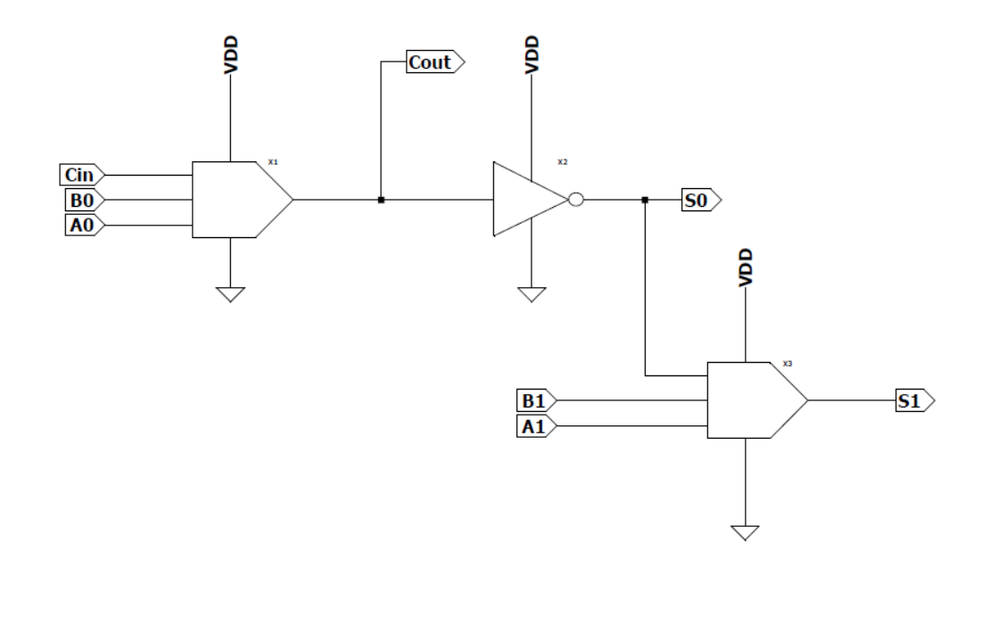
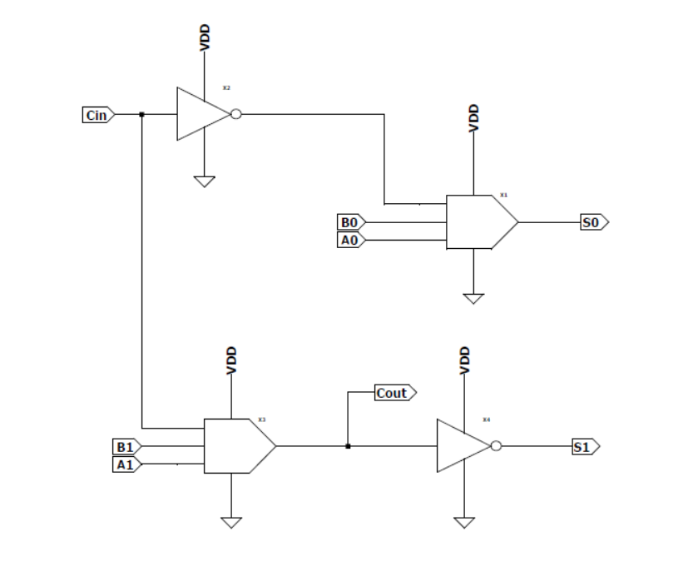
Figure 6.(c) : MLAFA11
Figure 6.(d) : MLAFA21

Slide 16
Proposed 2 – bit MLAFA from truth table reduction
For two operands A and B, there are four possible combinations. Under an assumed Gaussian distribution for image processing, A = 00 or B = 00 and A = 11 or B = 11 are not considered to ensure a low complexity by using a truth table. The reduced truth table is shown in the Table 5. The exact expressions for the outputs in these eight cases are given as:
Cout = M(A1, B1, Cin)
S0 = M(M(~A0, B0, Cin), M(A0, ~B0, Cin), ~Cin)
= M(M(A1, B0, Cin), M(A0, B1, Cin), ~Cin)
S1 = ~Cout
This design is hereafter referred to as MLAFA33
A1 | A0 | B1 | B0 | Cin | Cout | S1 | S0
0 | 1 | 0 | 0 | 0 | 0 | 1 | 1
0 | 1 | 0 | 0 | 1 | 1 | 0 | 0
0 | 1 | 0 | 1 | 0 | 0 | 1 | 0
0 | 1 | 0 | 1 | 1 | 0 | 1 | 1
1 | 0 | 1 | 0 | 0 | 1 | 0 | 0
1 | 0 | 1 | 0 | 1 | 1 | 0 | 1
1 | 0 | 1 | 1 | 0 | 0 | 1 | 1
1 | 0 | 1 | 1 | 1 | 1 | 0 | 0
Table 5 : Reduced truth table of 2-bit MLAFA

Slide 17
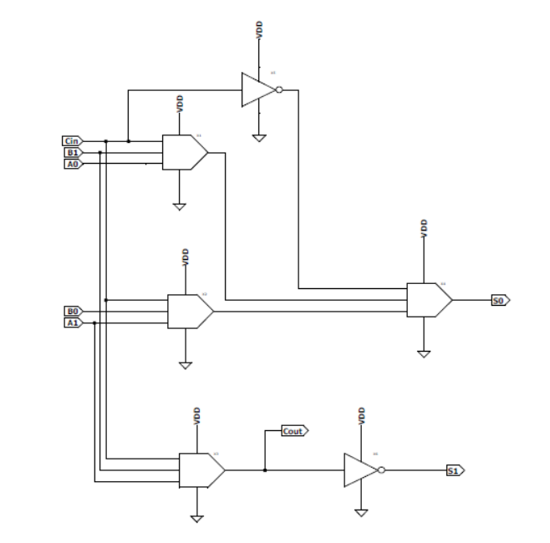
Types | ML | INV | D_{sum} (in ps) | D_{carry} (in ps) | NMED | MAE
MLAFA11 | 2 | 2 | 82 | 21 | 0.107 | 3
MLAFA22 | 2 | 1 | 52 | 0 | 0.107 | 3
MLAFA12 | 2 | 1 | 80 | 43 | 0.089 | 2
MLAFA21 | 2 | 2 | 47 | 32 | 0.089 | 2
MLAFA33 | 4 | 2 | 160 | 30 | 0.080 | 2
Table 6 : Comparison of 2-bit MLAFAs
Figure 6.(e) : MLAFA33 schematic diagram

Slide 18
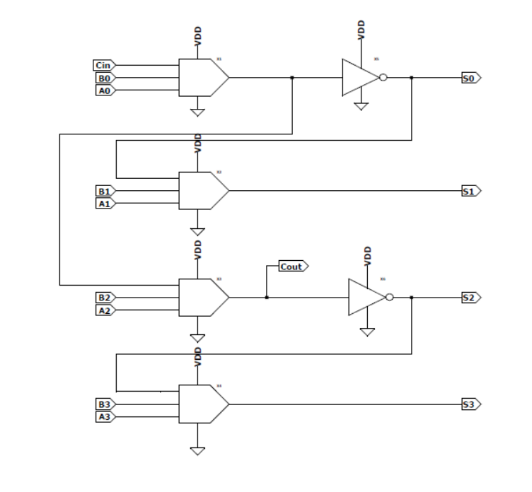
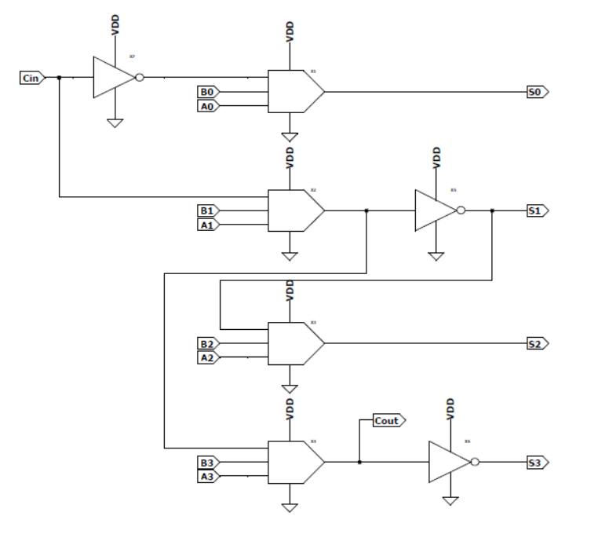
4 – Bit MLAFA
Figure 7.(a) : MLAFA1212
Figure 7.(b) : MLAFA2121

Slide 19
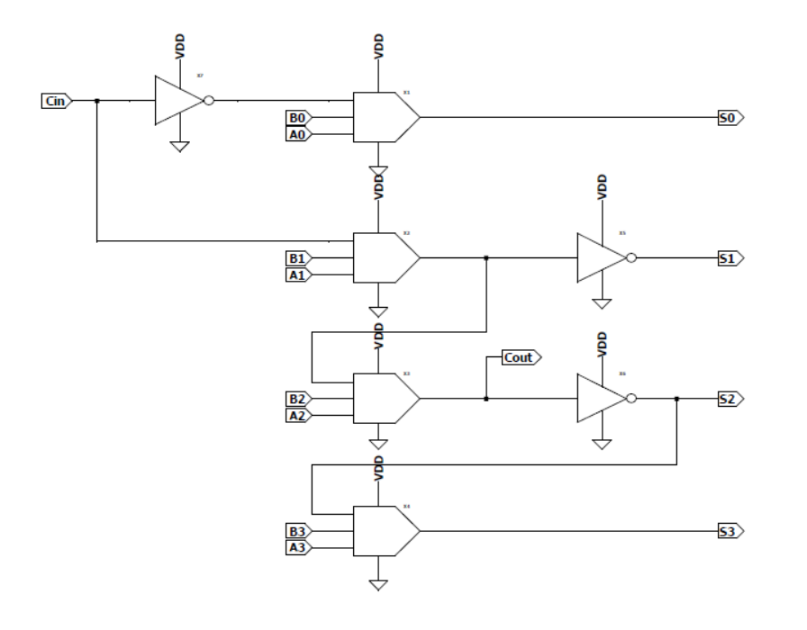
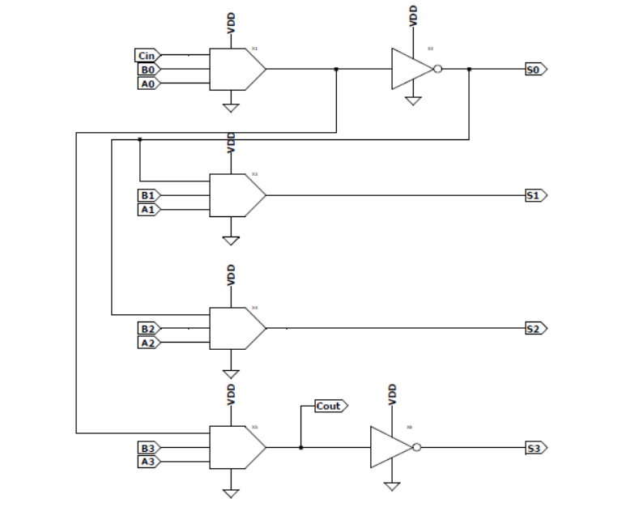
Figure 7.(c) : MLAFA2112
Figure 7.(d) : MLAFA1221

Slide 20
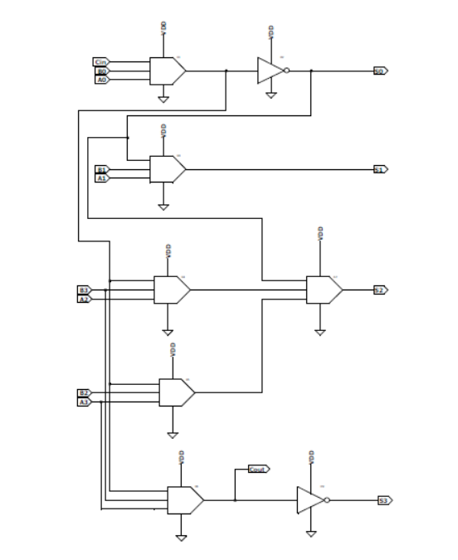
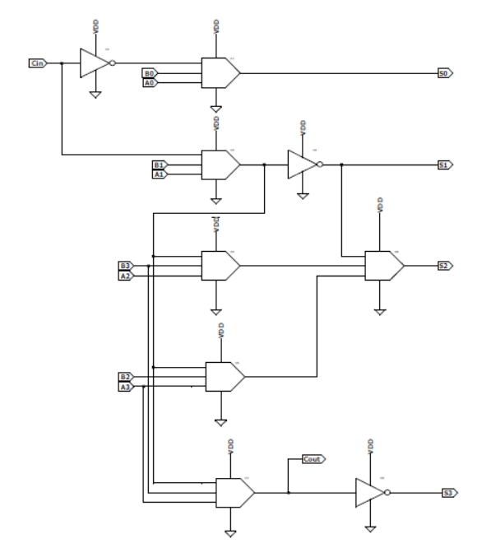
Figure 7.(e) : MLAFA2112
Figure 7.(f) : MLAFA2133

Slide 21
Types | ML | INV | D_{sum} (in ps) | D_{carry} (in ps) | NMED | MAE
MLAFA1212 | 4 | 2 | 286 | 172 | 0.091 | 10
MLAFA2121 | 4 | 3 | 189 | 171 | 0.092 | 10
MLAFA2112 | 4 | 3 | 284 | 172 | 0.092 | 10
MLAFA1221 | 4 | 2 | 181 | 172 | 0.175 | 10
MLAFA1233 | 6 | 2 | 334 | 234 | 0.083 | 9
MLAFA2133 | 6 | 3 | 334 | 234 | 0.081 | 10
Table 7 : Comparison of 4-bit MLAFAs

Slide 22
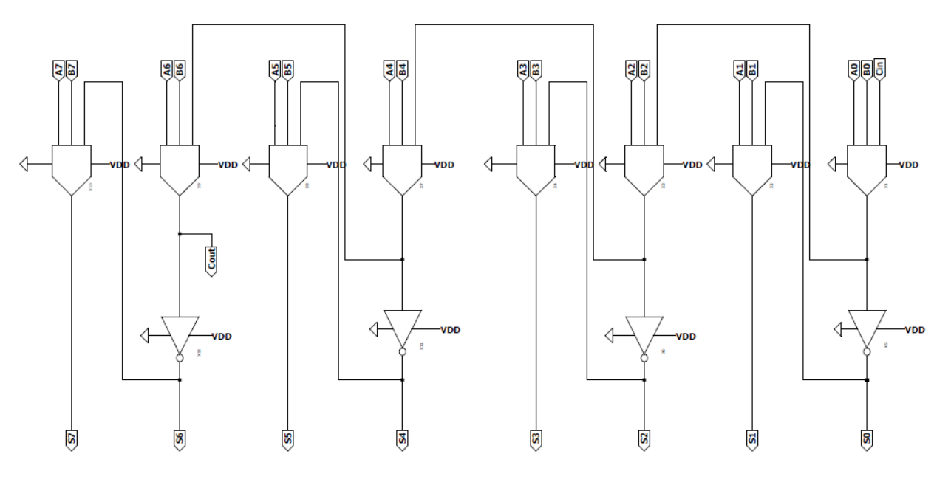
8 – Bit MLAFA
Figure 8.(a) : MLAFA1212-1212

Slide 23
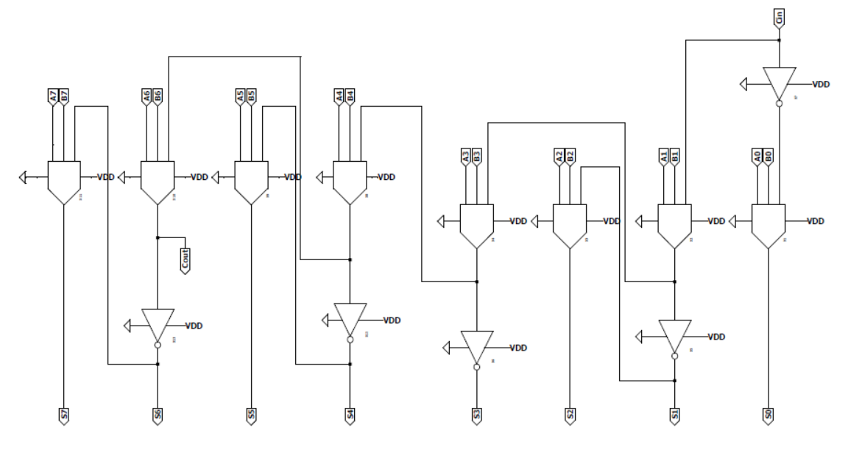
Figure 8.(b) : MLAFA2121-1212

Slide 24
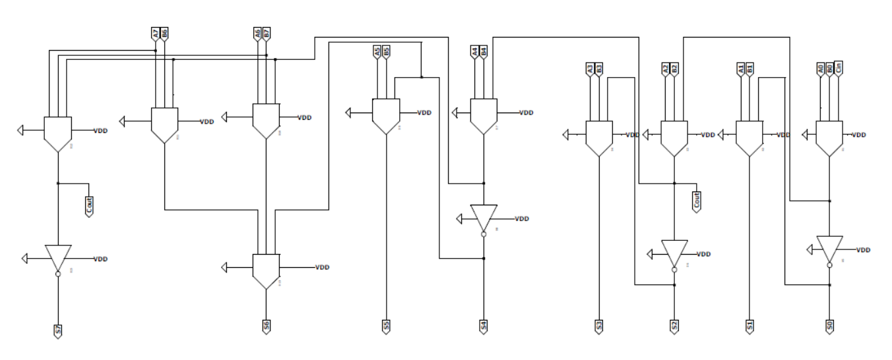
Figure 8.(c) : MLAFA1212-1233

Slide 25
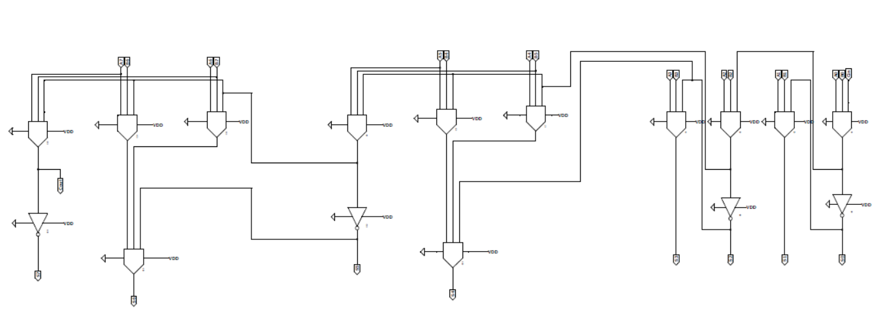
Figure 8.(d) : MLAFA1212-3333

Slide 26
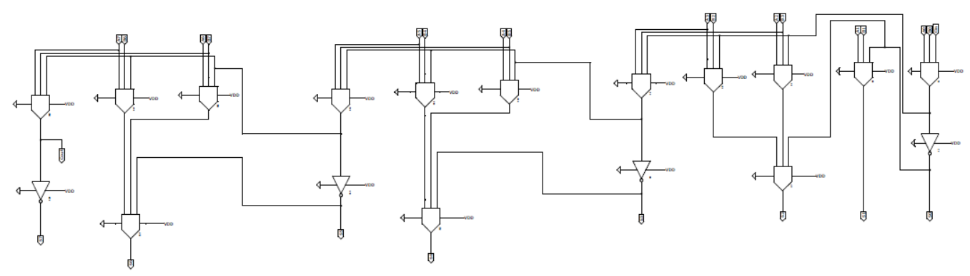
Figure 8.(e) : MLAFA1233-3333

Slide 27
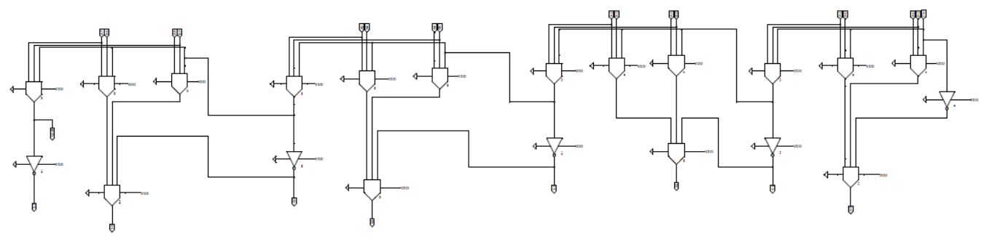
Figure 8.(f) : MLAFA3333-3333

Slide 28
Types | ML | INV | D_{sum} (in ps) | D_{carry} (in ps) | NMED | MAE
MLAFA1212-1212 | 8 | 4 | 460 | 360 | 0.090 | 170
MLAFA2121-1212 | 8 | 5 | 420 | 410 | 0.091 | 170
MLAFA1212-1233 | 10 | 4 | 410 | 130 | 0.082 | 149
MLAFA1212-3333 | 12 | 4 | 600 | 520 | 0.081 | 145
MLAFA1233-3333 | 14 | 4 | 680 | 580 | 0.080 | 169
MLAFA3333-3333 | 16 | 5 | 710 | 600 | 0.080 | 170
Table 8 : Comparison of 8-bit MLAFAs

Slide 29







Types | SSIM | PSNR(dB)
MLAFA1212-1212 | 0.2843 | 11.8691
MLAFA2121-1212 | 0.2819 | 11.8280
MLAFA1212-1233 | 0.7124 | 18.7737
MLAFA1212-3333 | 0.7987 | 20.5093
MLAFA1233-3333 | 0.8063 | 20.9441
MLAFA3333-3333 | 0.8166 | 21.8243
(a)
(b)
(c)
(d)
(e)
(f)
Table 9 : Image processing result of 8-bit MLAFAs
Figure 9 : Image processing result of 8-bit MLAFAs : (a) Original, (b) MLAFA1212-1212, (c) MLAFA2121-1212, (d) MLAFA1212-1233, (e) MLAFA1212-3333, (f) MLAFA1233-3333, (g) MLAFA3333-3333
(g)

Slide 30
IMPLEMENTATION (II. Approximate Compressor)

Slide 31
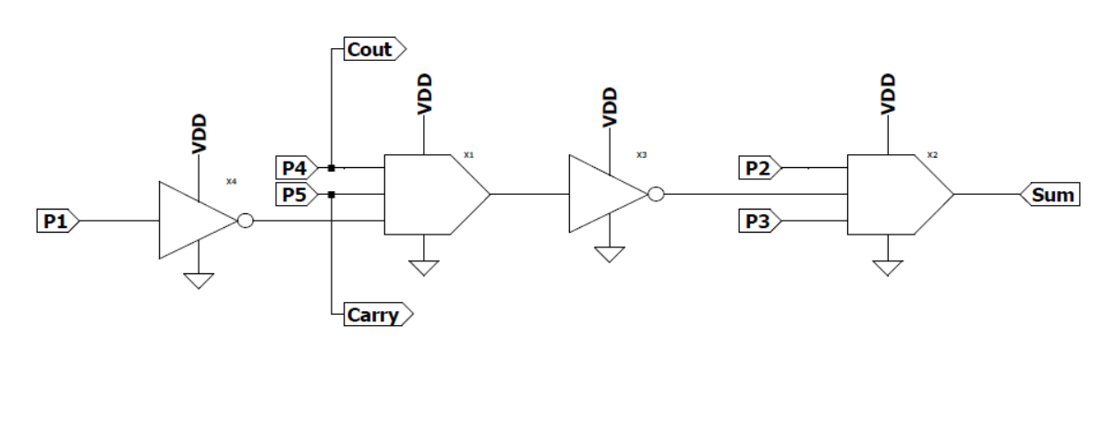
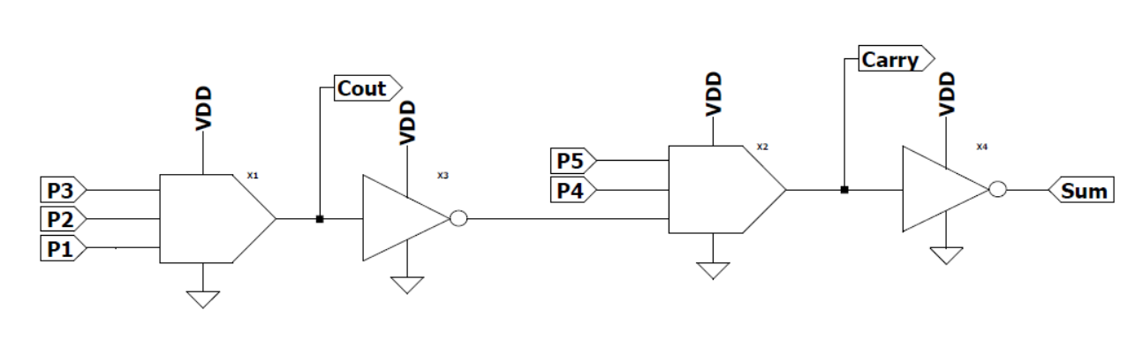
4:2 MLAC
Figure 10.(a) : MLAC1 schematic diagram
Figure 10.(b) : MLAC2 schematic diagram

Slide 32
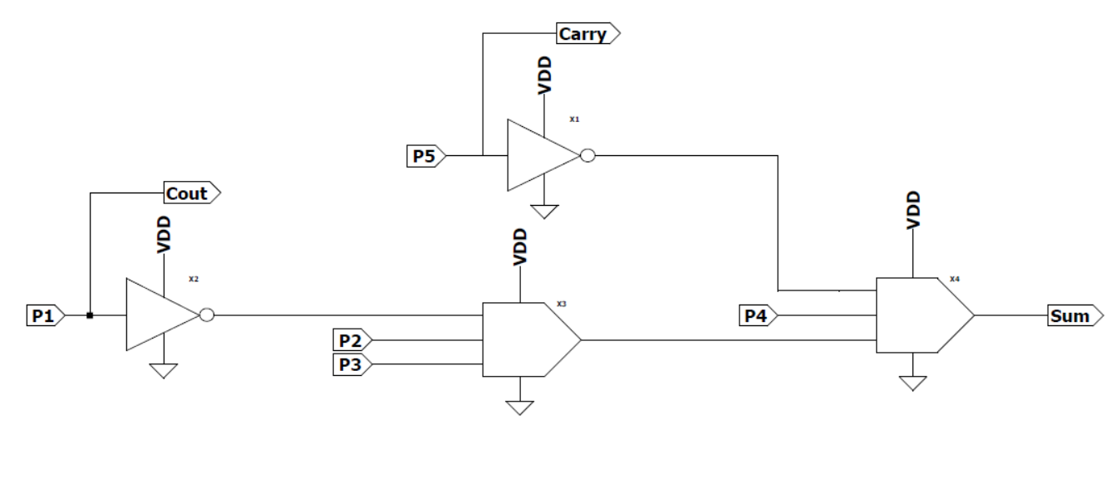
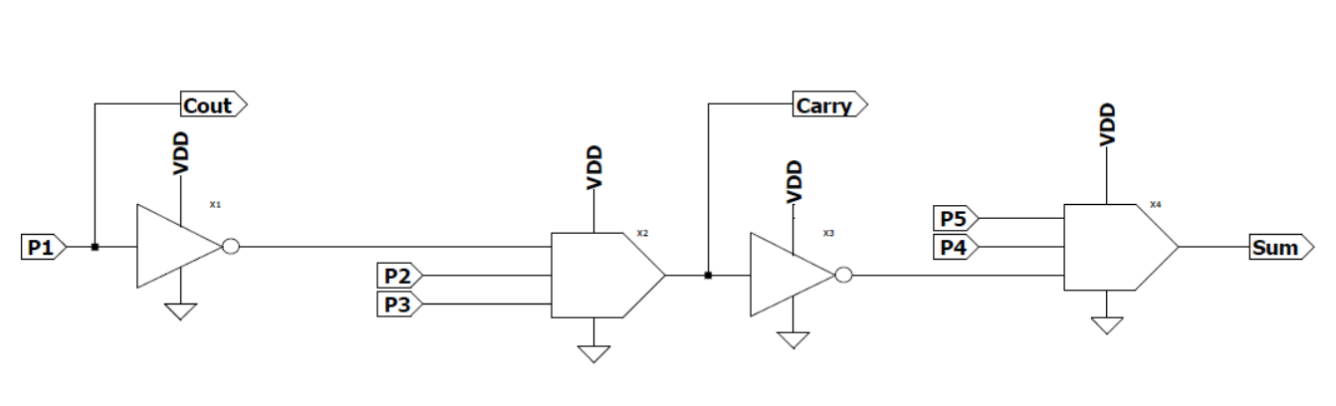
Figure 10.(c) : MLAC22-1 schematic diagram
Figure 10.(d) : MLAC22-2 schematic diagram

Slide 33
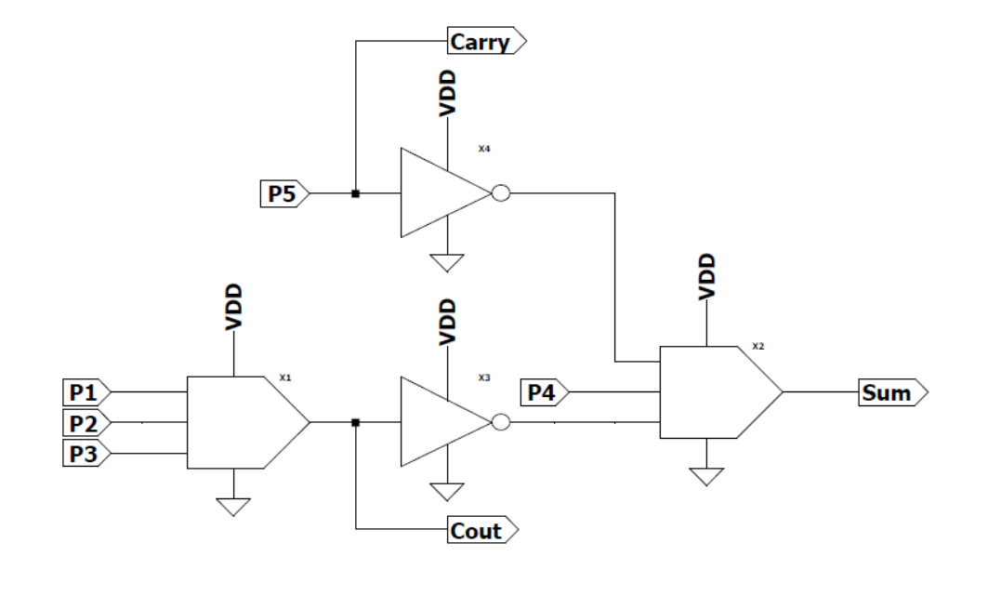
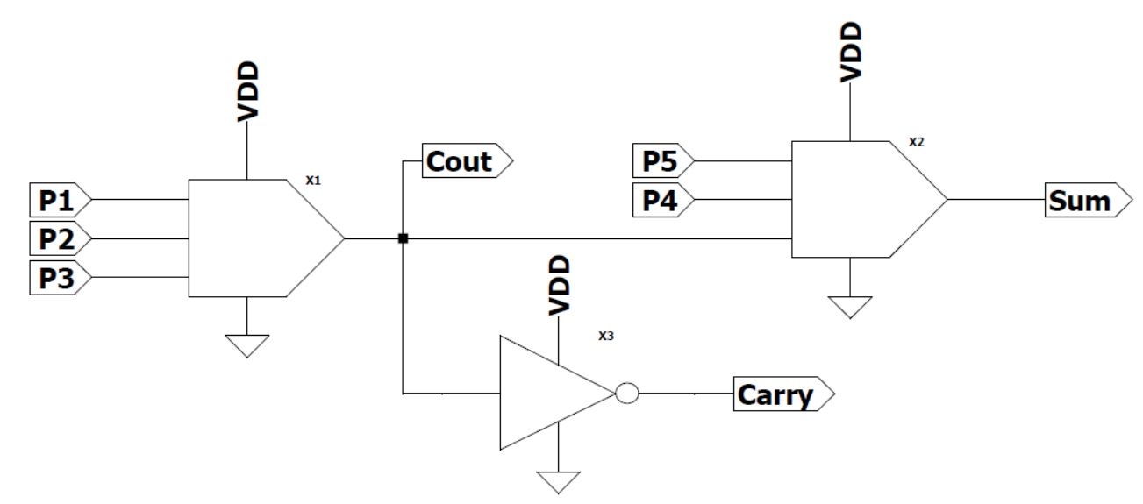
Figure 10.(e) : MLAC12-1 schematic diagram
Figure 10.(f) : MLAC12-2 schematic diagram

Slide 34
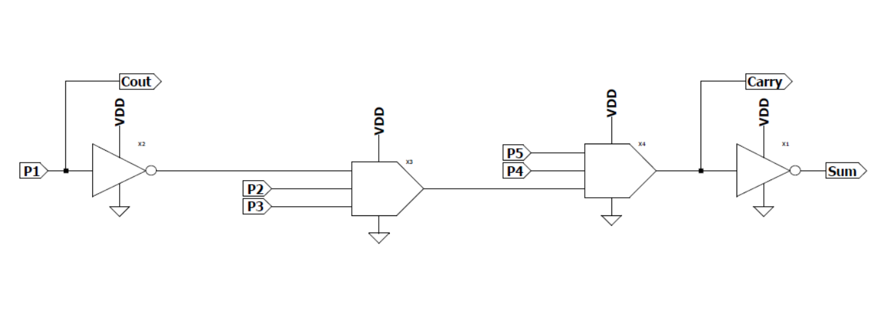
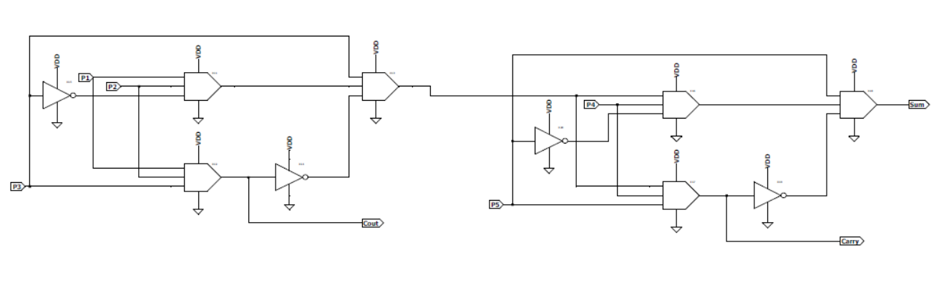
Figure 10.(g) : MLAC21 schematic diagram
Figure 10.(h) : EC schematic diagram

Slide 35
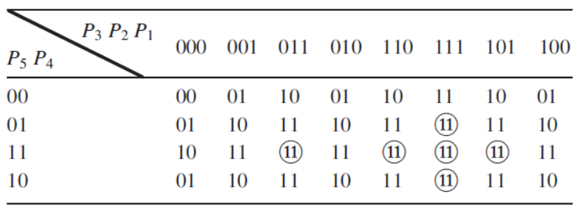
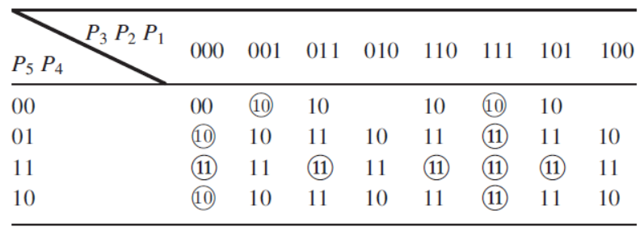
Proposed MLAC based on K-Map simplification
To further decrease the hardware complexity, an additional MLAC, namely MLAC4, is proposed; this circuit uses 2 outputs (rather than 3) for the final result.
The design of this MLAC is accomplished as per the following 3-step process:
Step 1: Approximation on the number of outputs. Use 2 outputs to denote the results so the binary 11 is employed to represent results larger than 11.
Step 2: Approximation of the expression for the K-map in Step 1. Depending on the properties of the majority logic, simplified equations can be found by introducing few errors.
Step 3: Computing the error distance by combining Step 1 and Step 2.
From the simplified K-Map, we can write:
Carry = M(M(P₃, P₂, P₁), M(P₅, P₄, 1), 1)
Sum = M(M(P₃, P₂, P₁), P₅, P₄)
Table 10 : K-Map of proposed MLAC4 after step 1
Table 11 : K-Map of proposed MLAC4 after step 2

Slide 36
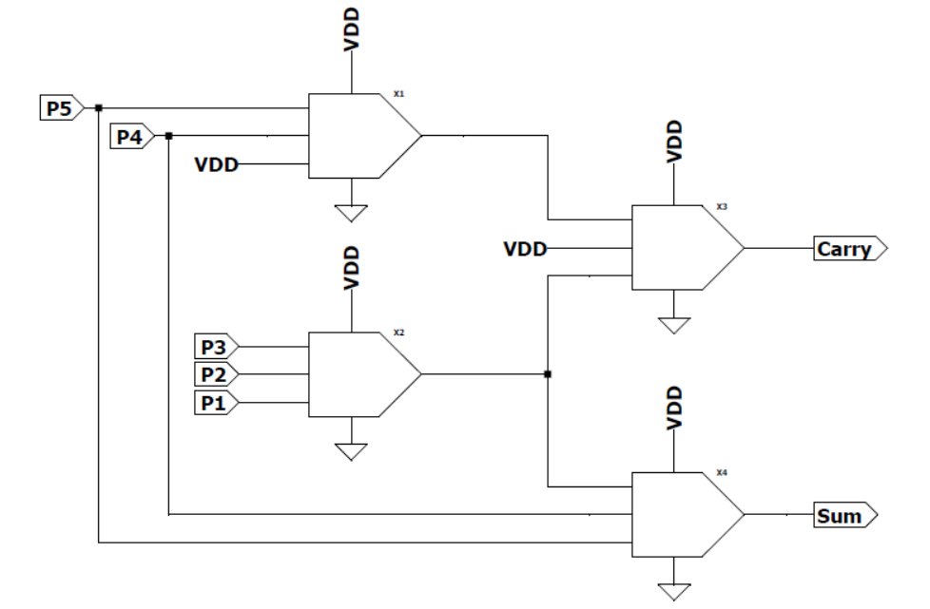
Types | ML | INV | D_{sum} (in ps) | D_{carry} (in ps) | NMED | MAE
EC | 6 | 4 | 378 | 317 | 0 | 0
MLAC1 | 2 | 2 | 211 | 0 | 0.1 | 2
MLAC2 | 2 | 2 | 181 | 163 | 0.075 | 1
MLAC22-1 | 2 | 2 | 184 | 0 | 0.1 | 2
MLAC22-2 | 2 | 2 | 212 | 115 | 0.075 | 1
MLAC12-1 | 2 | 2 | 155 | 0 | 0.075 | 1
MLAC12-2 | 2 | 1 | 154 | 99 | 0.1 | 2
MLAC21 | 2 | 2 | 214 | 196 | 0.1 | 2
MLAC4 | 4 | 0 | 179 | 174 | 0.087 | 3
Figure 10.(i) : MLAC4 schematic diagram
Table 12 : Comparison of 4:2 MLACs

Slide 37
IMPLEMENTATION (III. Approximate Multiplier)

Slide 38
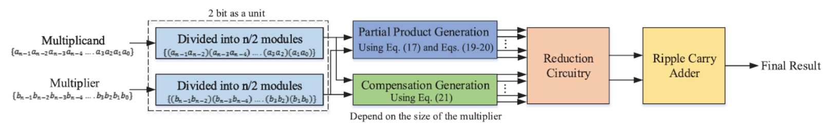
Figure 11 : Proposed design flow of n x n MLAMs

Slide 39
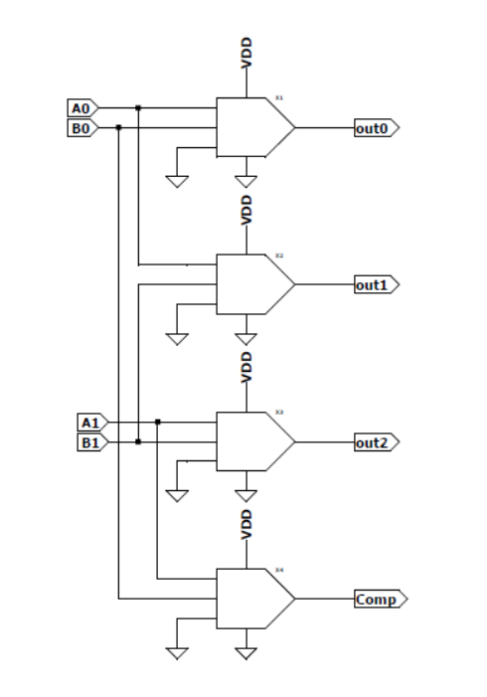
Partial Product Generation
For a 2 x 2 MLAM, let the multiplicand be A₁A₀ and the multiplier be B₁B₀.
Out₀ = M(A₀, B₀, 0)
Out₁ = M(A₀, B₁, 0)
Out₂ = M(A₁, B₁, 0)
∆ = M(A₁, B₀, 0)
where Out₀, Out₁, Out₂ are the partial products (PP) and ∆ represents a compliment bit
Figure 12 : 2x2 MLAM PP generation schematic diagram

Slide 40
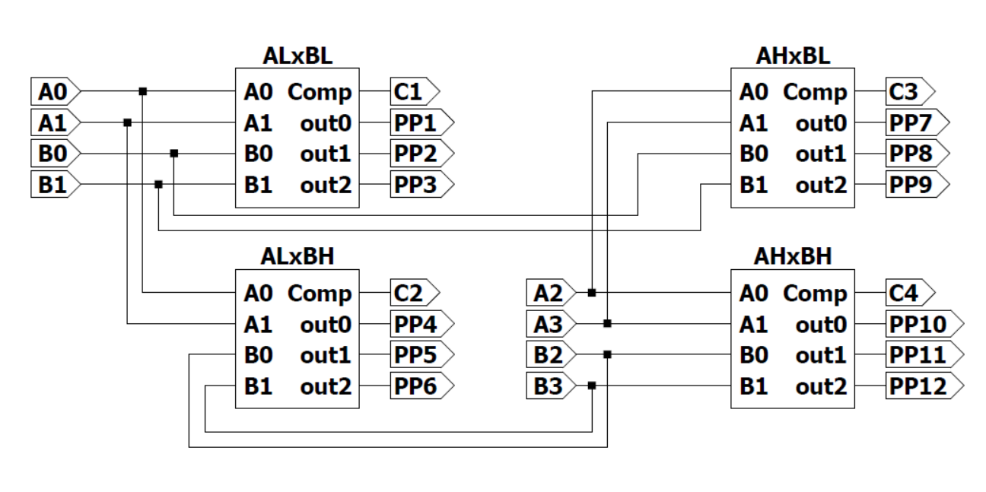
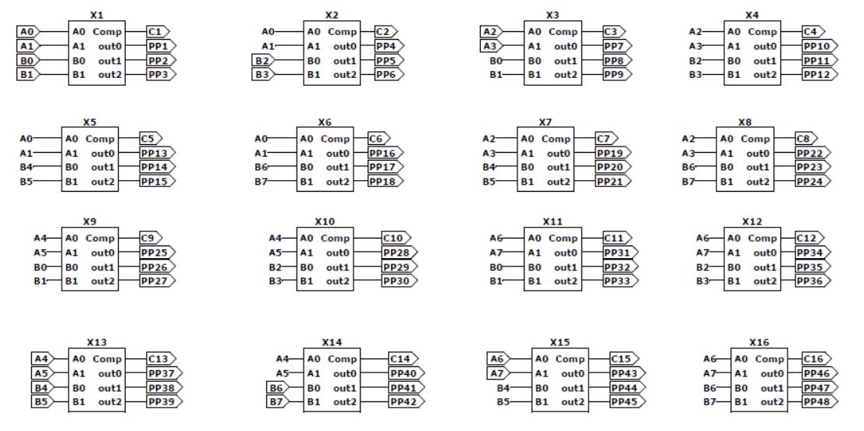
Figure 13 : 4x4 MLAM PP generation schematic diagram
Figure 14 : 8x8 MLAM PP generation schematic diagram

Slide 41
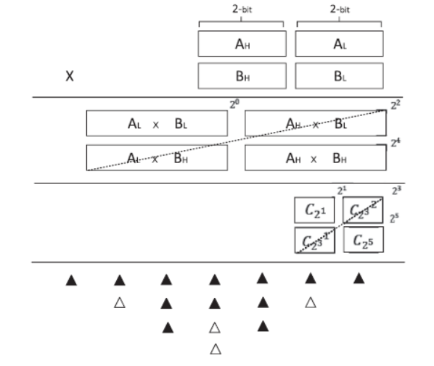
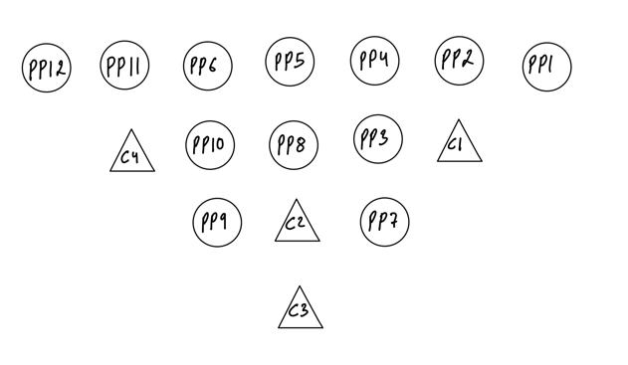
Figure 15 : 4x4 MLAM PP and complement bit generation

Slide 42
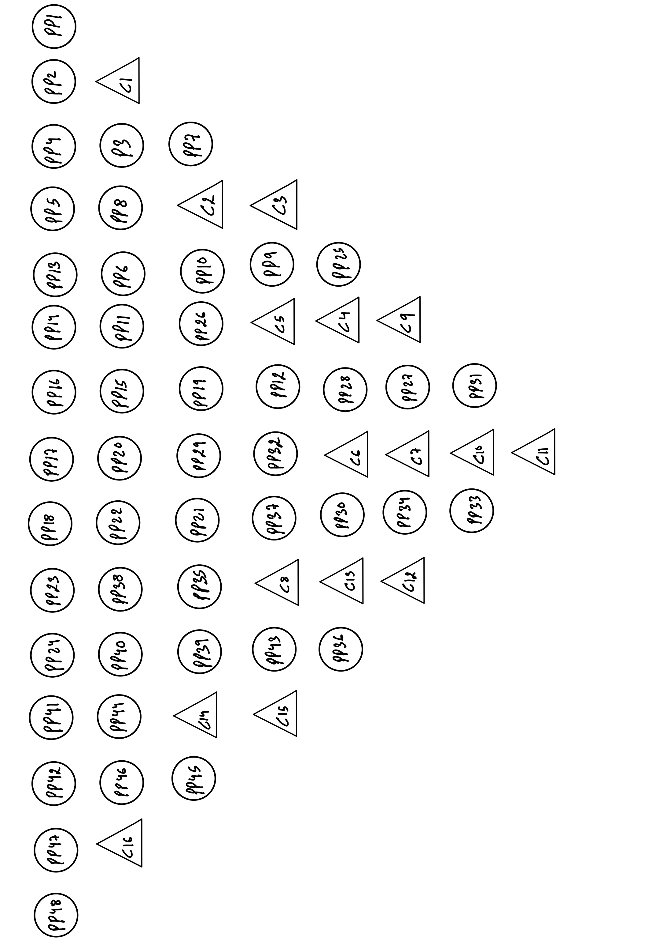
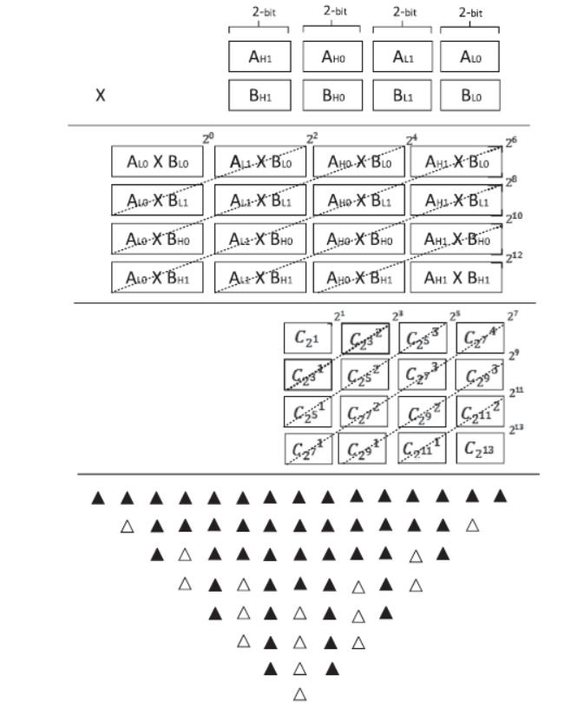
Figure 16 : 8x8 MLAM PP and complement bit generation schematic diagram

Slide 43
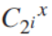
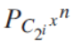
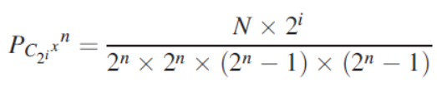
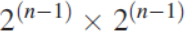
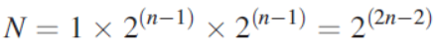
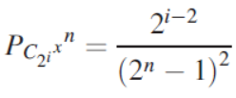
Complement Bit Selection
Too many compensation bits will lead to a larger overhead when calculating the subsequent compression; however, too few compensation bits will cause the final result to lose accuracy. Therefore, a tradeoff must be assessed when selecting an appropriate number of compensation bits.
When selecting the compensation bits and to control the error within a reasonable bound, the compensation bits for the lowest weight are ignored.
To measure the importance of each complement bit as well as to determine the ignored items, an influence factor denoted by is defined; this is required to show the impact of a complement bit on the final NMED. For an n x n MLAM, it can be expressed as follows:
where 2i denotes the weight of the complement bit; n denotes the size of the multiplier; N denotes the number of cases that the output (∆) is 1 when traversing all possible cases (as a function of n). Only when the inputs are both 1, ∆ is effective (and equal to 1). Except the two inputs of ∆, there are possible cases for the inputs of multipliers.

Slide 44
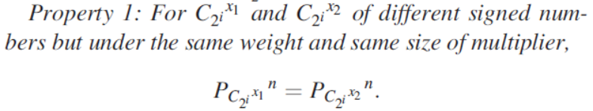
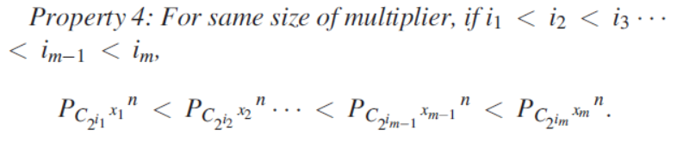



The influence factor has the following properties:

Slide 45



Table 12 : Value of Influence Factor when n = 4 and n = 8
Assuming that the number of ignored compensation bits is p; as of different complement bits are mutually independent and linearly superposed, the NMED of a n x n approximate multiplier is given by:
Similar to the above analysis, the expression for MAE can be found. Another influence factor denoted by EC2ix is defined; this is required to show the impact of a complement bit on the final MAE. For an n x n MLAM, it can be expressed as follows:
The MAE of a n x n approximate multiplier is given by:

Slide 46


Figure 17: Complement bit selection (NMED versus p): (a) 4 x 4 MLAM, and (b) 8 x 8 MLAM
Figure 18 : Complement bit selection (MAE versus p): (a) 4 x 4 MLAM, and (b) 8 x 8 MLAM2x2

Slide 47


4 x 4 MLAM
Figure 19 : 4x4 MLAM-EC (p=1) PPR circuitry
Figure 20 : 4x4 MLAM-EC (p=1) schematic diagram

Slide 48


Figure 21 : 4x4 MLAM-AC2 (p=1) PPR circuitry
Figure 22 : 4x4 MLAM-AC2 (p=1) schematic diagram

Slide 49


Figure 23 : 4x4 MLAM-AC2 (p=4) PPR circuitry
Figure 24 : 4x4 MLAM-AC2 (p=4) schematic diagram

Slide 50
Types | ML | INV | Delay (in ps) | NMED | MAE
4x4 MLAM-EC (p=1) | 39 | 16 | 1140 | 2.22 | 2
4x4 MLAM-AC2 (p=1) MLAC22-2 | 33 | 13 | 1024 | 14.44 | 12
4x4 MLAM-AC2 (p=4) | 24 | 9 | 812 | 61.59 | 66
Table 13 : Comparison of 4x4 MLAMs

Slide 51

8 x 8 MLAM
Figure 25 : MLAM1_8X8_p1 [8x8 MLAM using 4x4 and exact PPR] schematic diagram

Slide 52

Figure 25 : MLAM1_8X8_p1 PPR circuitry

Slide 53

Figure 27 : 8x8 MLAM (p=10) (using 2x2 MLAM and exact PPR) schematic diagram

Slide 54

Figure 28 : 8x8 MLAM (p=10) (using 2x2 MLAM) PPR circuitry

Slide 55

Figure 29 : MLAM3_8X8_p10_MLAC4 [8x8 MLAM using 2x2 and approximate PPR] schematic diagram

Slide 56




Figure 30 :Approximate PPR circuitry design for 8 x 8 MLAMs: (a) MLAC (2 outputs) based (p = 10), and (b) MLAC (3 outputs) based (p = 10).

Slide 57
Types | ML | INV | Delay (in ps) | NMED | MAE
MLAM1_8x8_p1 | 189 | 90 | 3184 | 0.0131 | 3468
MLAM2_8x8_p1 | 173 | 82 | 3082 | 0.0191 | 6572
MLAM3_8x8_p10_MLAC4 | 120 | 36 | 2475 | 0.0267 | 9120
MLAM4_8x8_p10_MLAC22-2 | 116 | 52 | 2228 | 0.0318 | 9476
MLAM5_8x8_p10_MLAC12-1 | 116 | 52 | 2171 | 0.0346 | 9820
Table 13 : Comparison of 8x8 MLAMs

Slide 58










Types | SSIM | PSNR(dB)
MLAM5_8x8_p10 | 0.8568 | 14.5279
MLAM4_8x8_p10 | 0.9441 | 22.0034
MLAM3_8x8_p10 | 0.9532 | 25.5093
MLAM2_8x8_p1 | 0.9611 | 30.3539
MLAM1_8x8_p1 | 0.9705 | 36.6246
Table 14 : Image processing result of 8x8 MLAMs
Figure 31 : Image processing result of 8-bit MLAFAs : (a) Original, (b) MLAM5_8x8_p10, (c) MLAM4_8x8_p10, (d) MLAM3_8x8_p10, (e) MLAM2_8x8_p1, (f) MLAM1_8x8_p1

Slide 59
Epilogue
This paper has presented a design, analysis and evaluation of majority logic based approximate adders and approximate multipliers. The following conclusions can be drawn:
By combining the proposed 1-bit MLAFA and the existing 1-bit MLAFA, multi-bit MLAFAs can be designed with a relatively large error. The proposed MLAFA33 designed by truth table reduction can provide the solution for improving accuracy. For 8-bit adders, MLAFA1212-1233 (with a reduction of 58 percent in majority gates as well as 50 percent in delay) and MLAFA1212-3333 (with a reduction of 50 percent in majority gates as well as 50 percent in delay) are superior to other designs.
Based on the proposed 2 x 2 MLAM, we can selectively design multi-bit multipliers by adding the complement bits. From the presented theoretical analysis, for a 4 x 4 multiplier, when p changes from 3 to 4, the NMED increases sharply; for an 8 x 8 multiplier, when p is smaller than 10, the NMED increases slowly but when p is larger than 10, the NMED increases rapidly. So p = 3 and p = 10 are the best choices for the 4 x 4 multiplier and the 8 x 8 multiplier, respectively.
MLAC22-2 and MLAC12-1 show the best overall performance among these MLACs based on MLAFAs. Compared with the exact design, the proposed designs save 67 percent of majority gates, 50 percent of inverters, 50 percent of delay and 67 percent of carry chain. Although MLAC4 requires two additional 3-input majority gates, MLAC4 only has 2 outputs, which is likely to reduce the approximate operation in the PPR circuitry. The MLAC4 based 8 x 8 multiplier using 2 x 2 multipliers (p = 10) reduces the number of majority gates by up to 48 percent, the number of inverters by up to 67 percent, and the delay by up to 47 percent compared to the exact counterpart, achieving a significant decrease of hardware without incurring in large errors.

Slide 60
References
C. Labrado, H. Thapliyal and F. Lombardi, "Design of majority logic based approximate arithmetic circuits", Proc. IEEE Int. Symp. Circuits Syst., pp. 2122-2125, 2017.
S. Angizi, H. Jiang, R. F. DeMara, J. Han and D. Fan, "Majority-based spin-CMOS primitives for approximate computing", IEEE Trans. Nanotechnol., vol. 17, no. 4, pp. 795-806, Jul. 2018.
C. Chang, J. Gu and M. Zhang, "Ultra low-voltage low-power CMOS 4–2 and 5-2 compressors for fast arithmetic circuits", IEEE Trans. Circuits Syst. I, vol. 51, no. 10, pp. 1985-1997, Oct. 2004.
H. Cho and E. E. Swartzlander, "Adder and multiplier designs in quantum dot cellular automata", IEEE Trans. Comput., vol. 58, no. 6, pp. 721-727, Jun. 2009.
V. Pudi and K. Sridharan, "Low complexity design of ripple carry and Brent-Kung adders in QCA", IEEE Trans. Nanotechnol., vol. 11, no. 1, pp. 105-119, Jan. 2012.
S. Mittal, "A survey of techniques for approximate computing", ACM Comput. Surv., vol. 48, no. 4, 2016.
S. L. Eddins and M. T. Orchard, "Using MATLAB and C in an image processing lab course", Proc. First Int. Conf. Image Process., vol. 1, pp. 515-519, 1994.

Slide 61
Thank you

